Slide 1
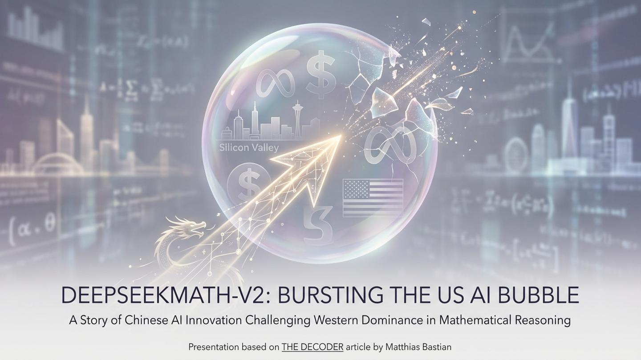

Slide 2
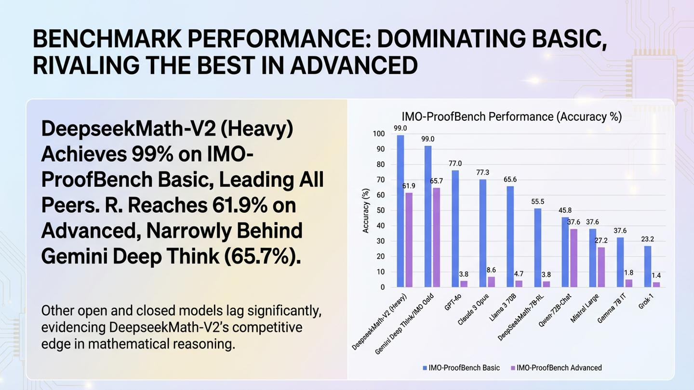

Slide 3
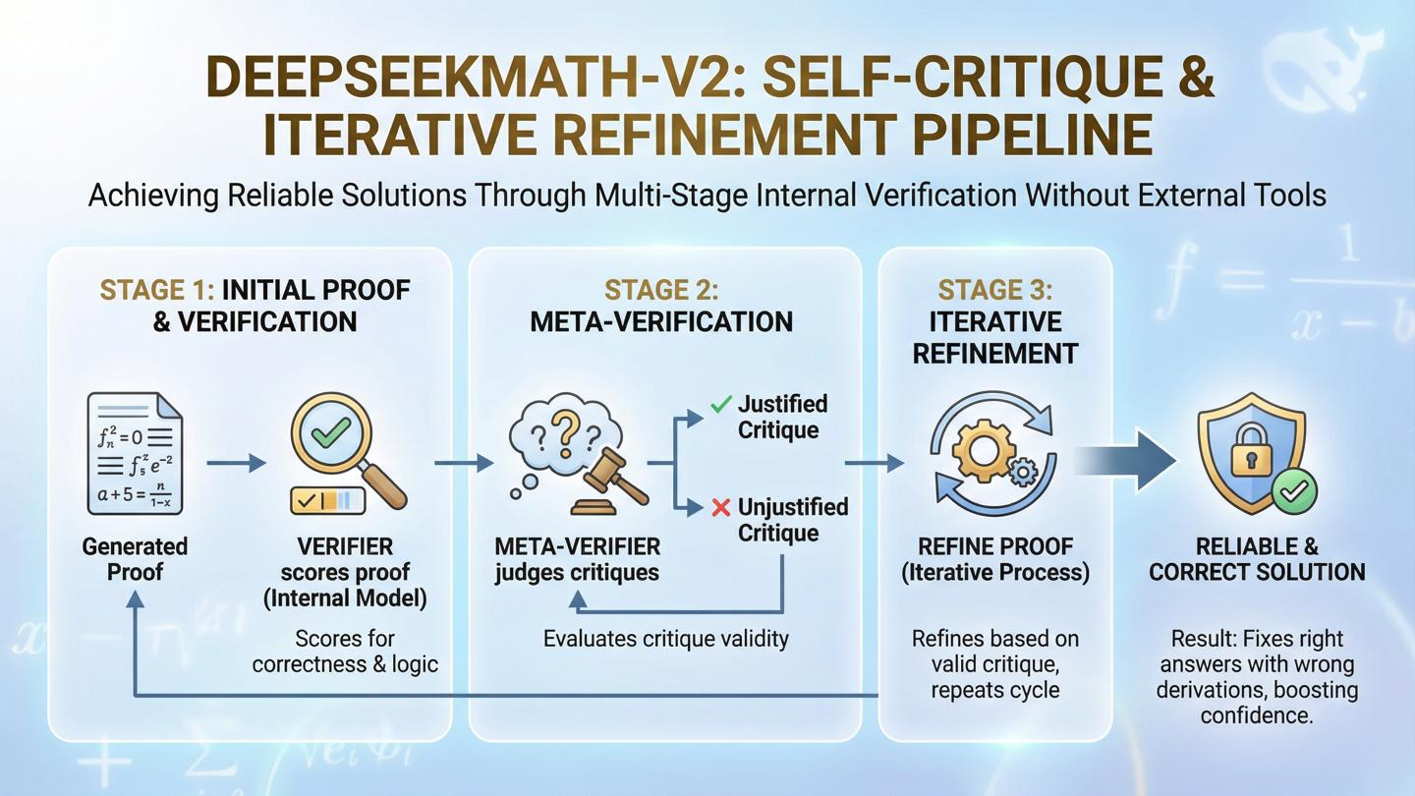

Slide 4
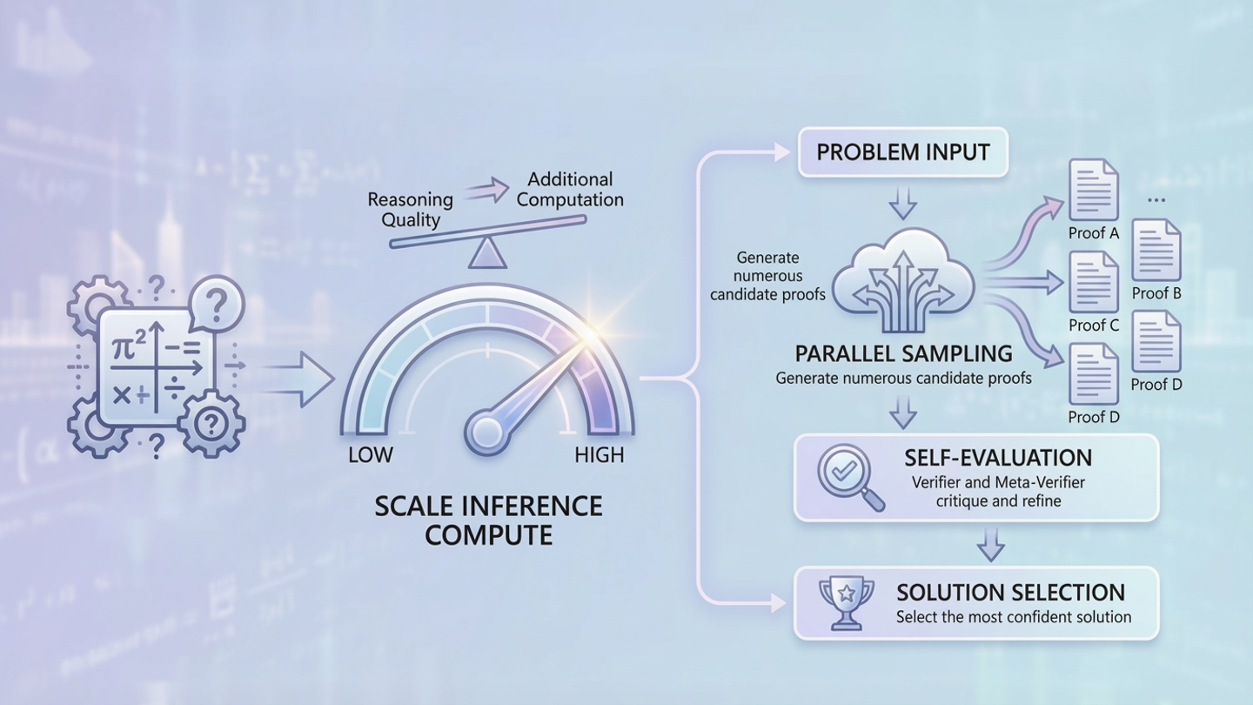
DEEPSEEKMATH-V2: SCALING INFERENCE FOR HARDER PROBLEMS
Trading Reasoning Quality for Additional Computation
HARDER PROBLEMS
This strategy lifts accuracy at contest level, mirroring human practice of checking multiple approaches.

Slide 5
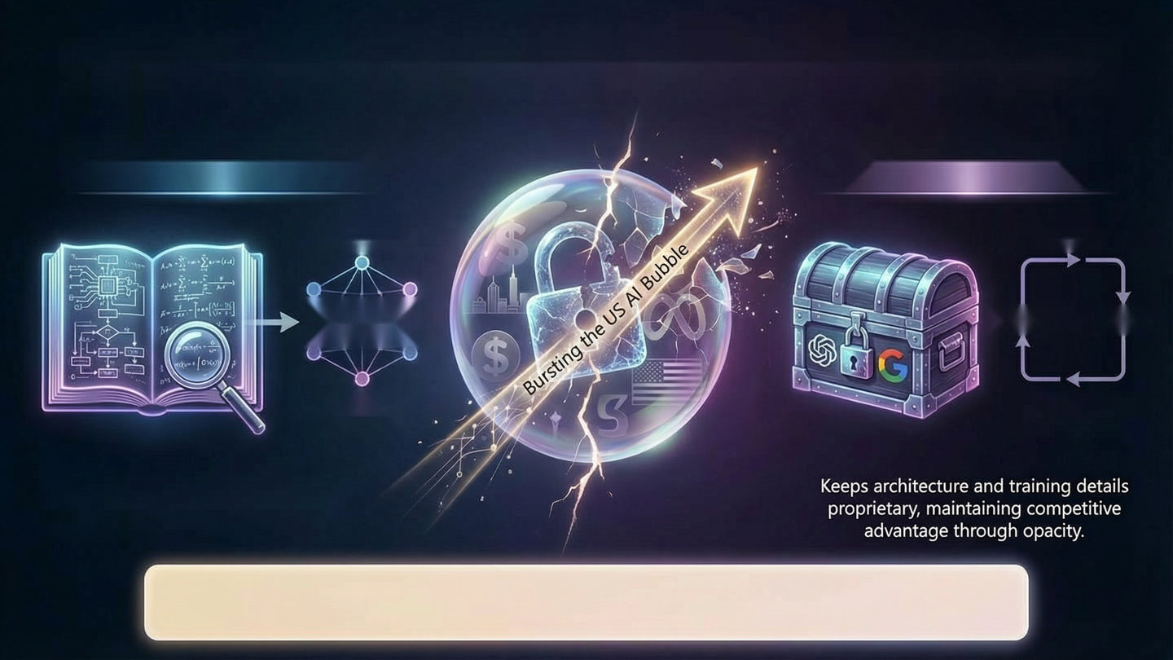
THE OPENNESS OFFENSIVE: DEEPSEEK'S STRATEGIC TRANSPARENCY.
Challenging Western AI Dominance Through Full Architectural Disclosure.
DEEPSEEK: FULL ARCHITECTURAL DETAILS
OPENAI & GOOGLE: WITHHOLD SPECIFICATIONS
Transparency
Secrecy
Global
Collaboration
Secrecy Mystique
Accelerated Replication
Justify Closed Development
Keeps architecture and training details proprietary, maintaining competitive advantage through opacity.
Publishes complete technical papers, fostering open research and rapid innovation.
Deepseek's transparency is a strategic weapon, undercutting US dominance, inviting global replication, and intensifying pressure on Western labs to justify their closed models.

Slide 6
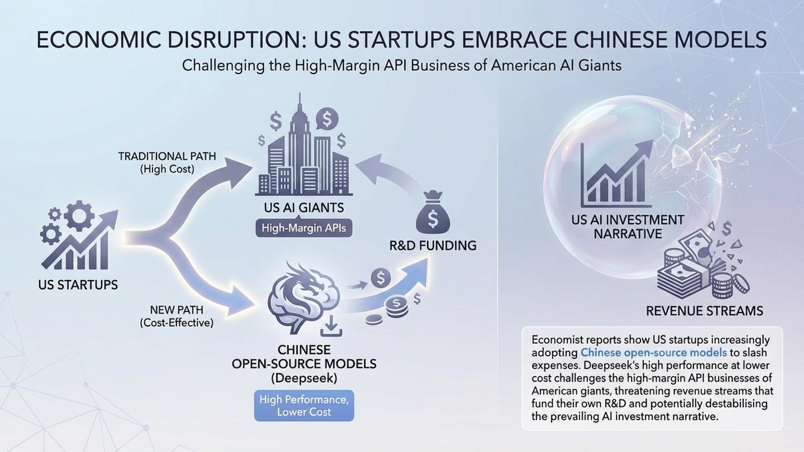

Slide 7
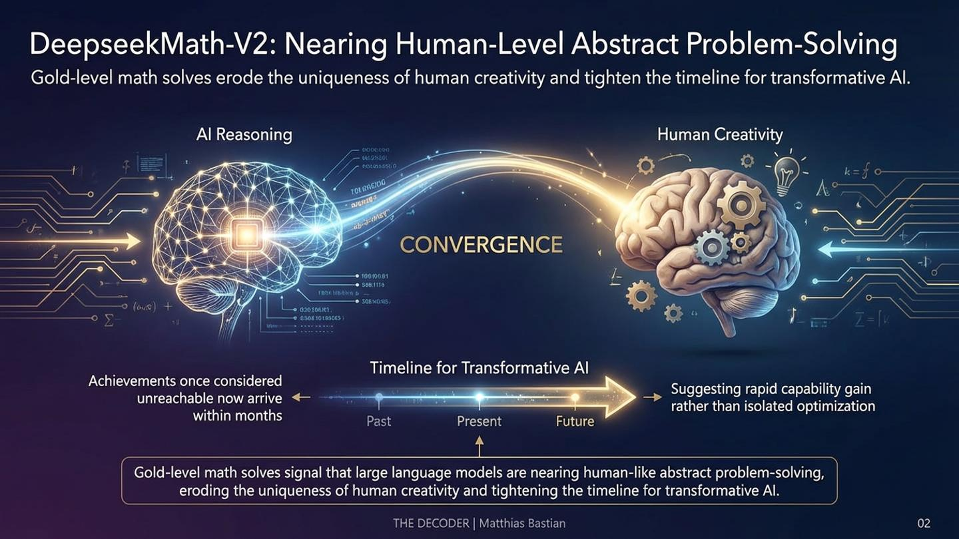

Slide 8
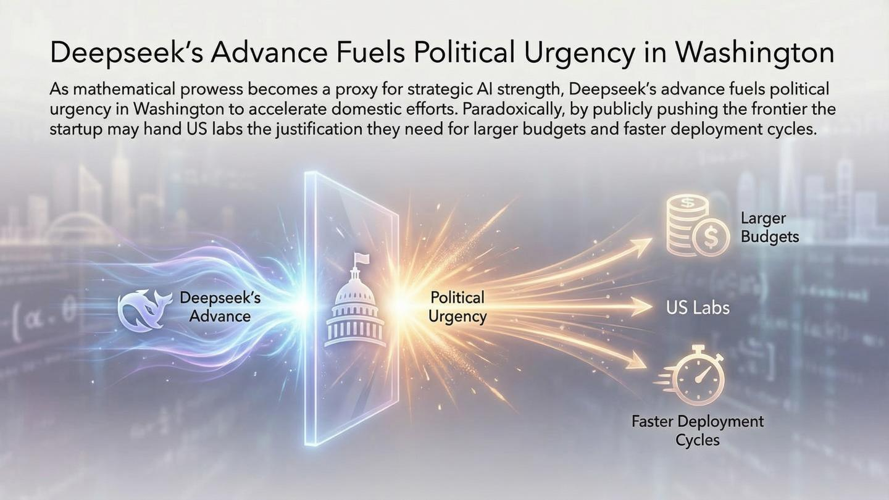

Slide 9
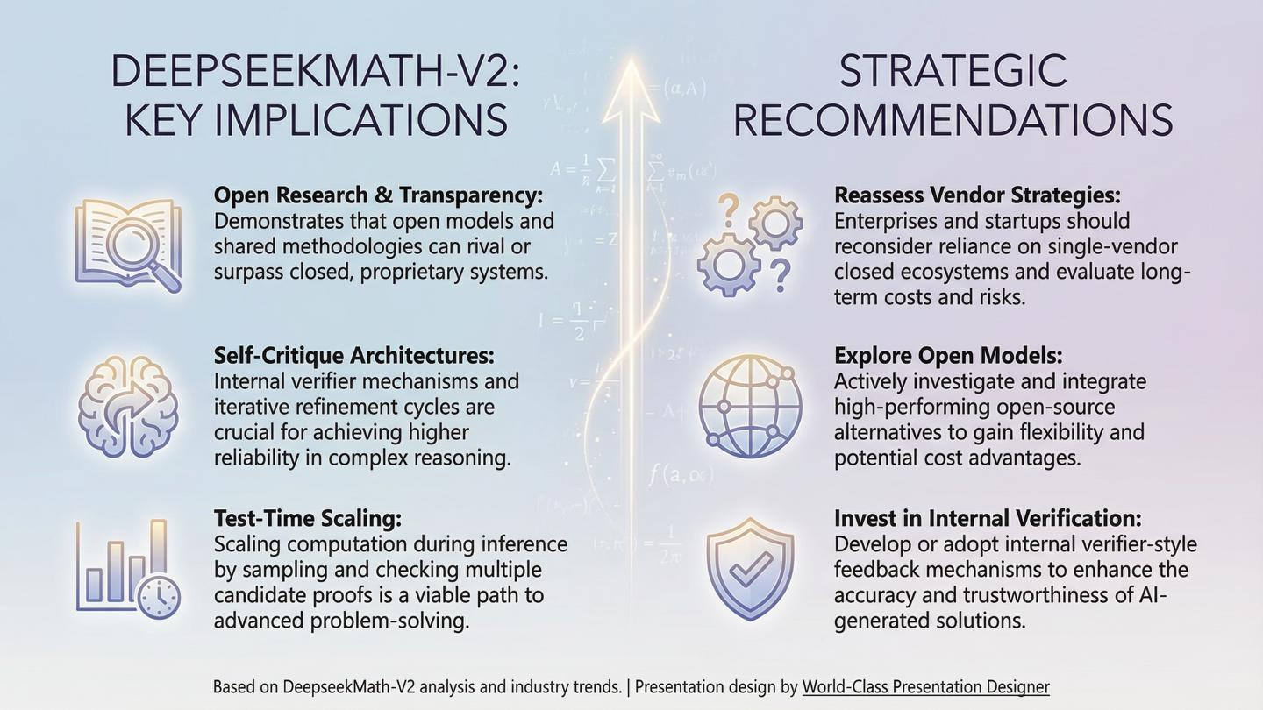

Slide 10
